Slide 1
Together Mentoring and Networking Programme
Orientation Webinar
28 November 2022
Time: 9:00-10:30 AM (EST)
Please check that you are muted, thank you!

Slide 2
Agenda
Overview
How does it work?
Networking feature
Best practices
Q&A

Slide 3
Programme overview
Based on a spirit of generosity and civility.
Democratizes mentoring…making it possible for everyone, regardless of category, level, job network or UN system entity.
An external software platform
Registration and pairing are ongoing

Slide 4
How Does it Work? 6 Steps
01
Staff register
02
Mentees search for suitable mentors
03
Mentors receive requests
04
Mentees are notified of mentor approvals and should schedule first sessions
05
Pairs should meet regularly
06
Provide feedback.

Slide 5
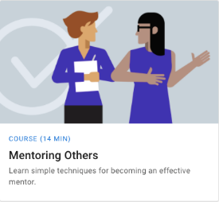
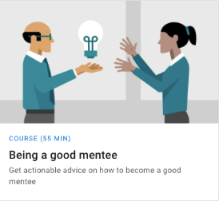
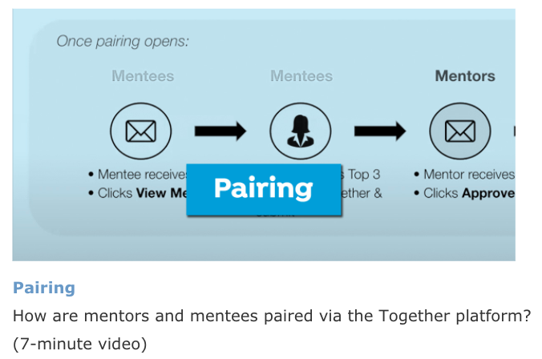
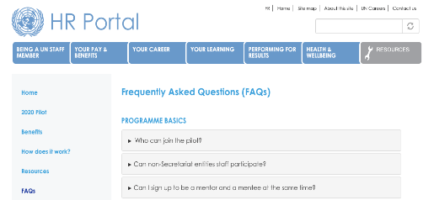
Resources
Mentee Handbook
Session agendas
Compiled list of relevant online courses, articles and videos
Customized videos on using the Together Platform
Frequently Asked Questions (FAQs)

Slide 6
Important Pairing Tips
FOR MENTEES
Reflect on what you want to get out of the programme
Set appropriate expectations
Not linked to promotions
Thoroughly review mentor profiles; align your selections with your goals
Understand that you may not get your first choice.
FOR MENTORS
Ensure your profile is updated with your mentee capacity.
Consider your availability in coming months
Check your emails for mentee requests – starting today (mentorship@togetherplatform.com)
Review mentee profiles to ensure a good fit
Accept or decline requests within 3 days

Slide 7
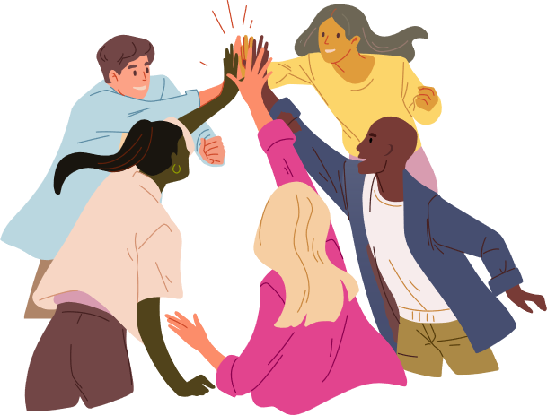
Networking Overview
What is networking?
How can it help me?
Should I choose networking or mentoring?

Slide 8
What makes a good mentor?
Our mentees believe these are the most important qualities a mentor should have:

Slide 9
Best practices
The foundation of a great relationship:
Trust
Respect
Communication

Slide 10
Best practices for mentoring
What does a mentor do?
Advises
Shares institutional and professional wisdom, provides input on performance, makes suggestions.
Coaches
Helps the mentee learn new skills and practice new behaviours.
Supports
Actively listens, explains unwritten rules, and acknowledges disappointments and triumphs.

Slide 11
Best practices
Dos and Don’ts for Mentors
Dos
Don’ts
1
Set realistic expectations
1
Act like you know more than you do
2
Listen, listen, and then listen some more
2
Take your role lightly
3
Attempt to solve all your mentee's problems
3
Keep an open mind
Encourage your mentee to become a mentor themselves – by example
4
Take over
4

Slide 12
Best practices for mentoring
How to be a good mentee:
1
2
3
4
5
Know what you want
Be prepared
Take action on the advice
Think Critically
Show gratitude, honesty and respect

Slide 13
FAQ's
How does the scheduling work in the platform?
What do I do if the mentee/mentor is not a good fit?
What do I do if I missed the approval for my mentee?
How do I effectively prepare for my session? What are things not to do in my session?
Do I need to complete feedback? Does this get shared with my mentor/mentee?
What happens if I am not getting emails?

Slide 14
Questions & Answers
Q&A
.
Write your questions in the chat-box.
Or raise your hand to speak.
Notes:
Now it’s the time to take your questions. Feel free to raise your hand or type in the chat-box.

Slide 15
Closing
Resource Links
Thank you!
The link to the resources on the HR Portal are here: https://hr.un.org/together-resources
The link to the same resources on the platform are here: United Nations - Together Mentorship Platform (togetherplatform.com)
Please answer a one-minute feedback survey on this session.
Contact us at mentoring@un.org
Navigation Links
Use the QR code or click the link in the chat-box to access.
The link to your profile is here: https://my.togetherplatform.com/user/profile
The link to the HR Portal is here: https://hr.un.org/mentoring
15/20

